Slide 1


Welcome to the MN M365 Fall Admin Workshop Day 2021!
Please help us drive event awareness by tweeting and posting about your experience at the Workshop:
@o365MN #M365WorkshopDay
Thank you for your participation!

Slide 2







Thank You To Our Sponsors!

Slide 3
Oh No! The Presentation is TODAY?!?!?!?!?
It’s a Live Event AND a Teams Meeting?
How am I going to show both within Microsoft Teams?
It’s going to be an inception thing (Teams meeting about a Teams webinar and a Teams Live Event)
This is going to be tricky to say the least
Live Events, 3rd party services, OBS – Open Broadcaster Software, Live Events vs a Webinar)
I wonder how a TV network would handle this?

Slide 4
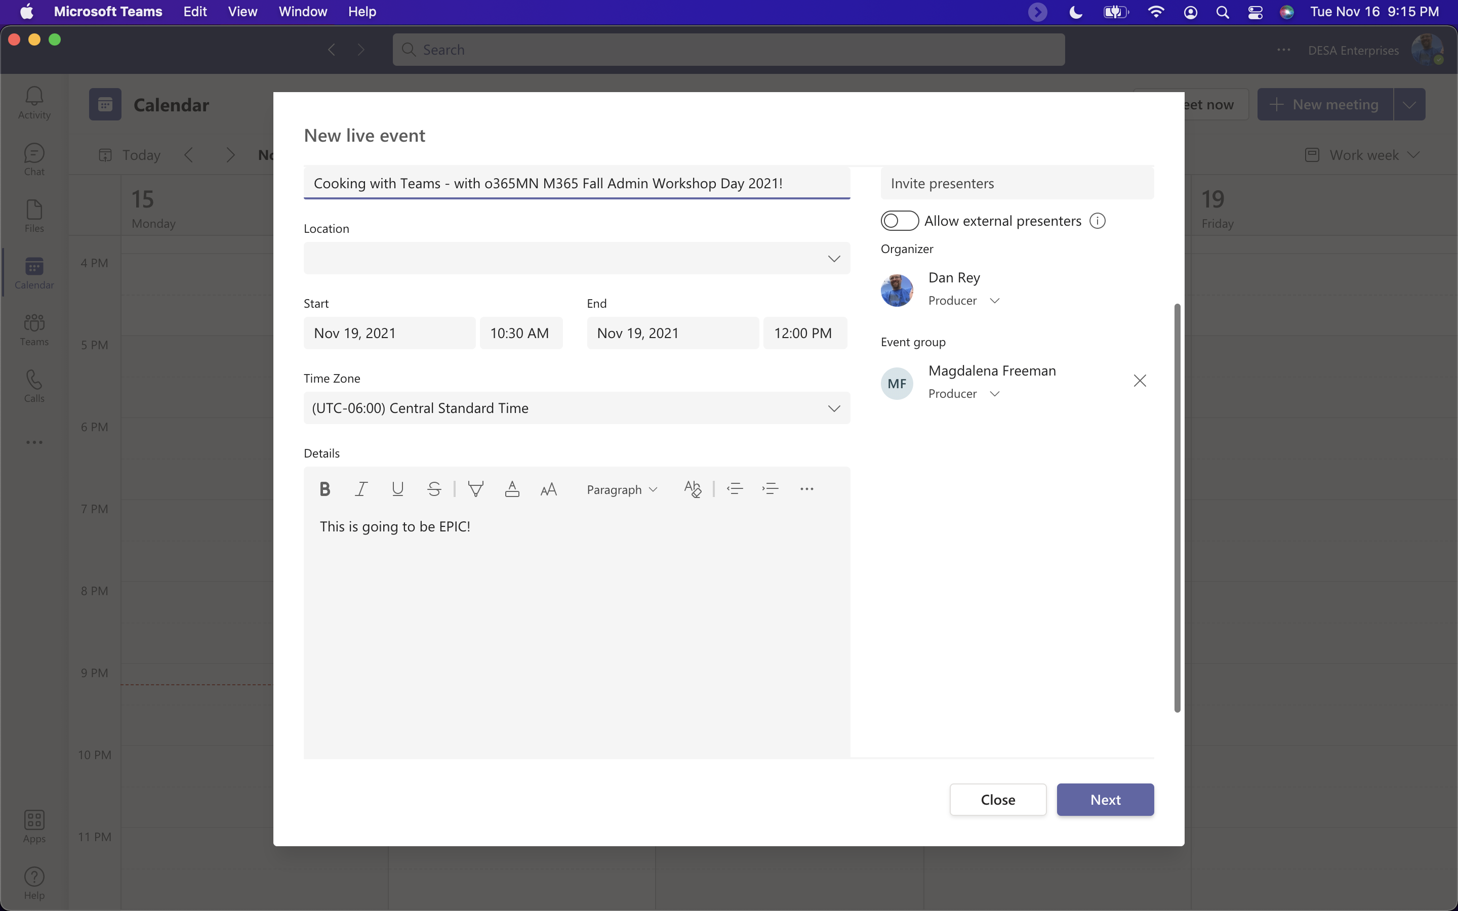
Live Events are PRODUCED

Slide 5
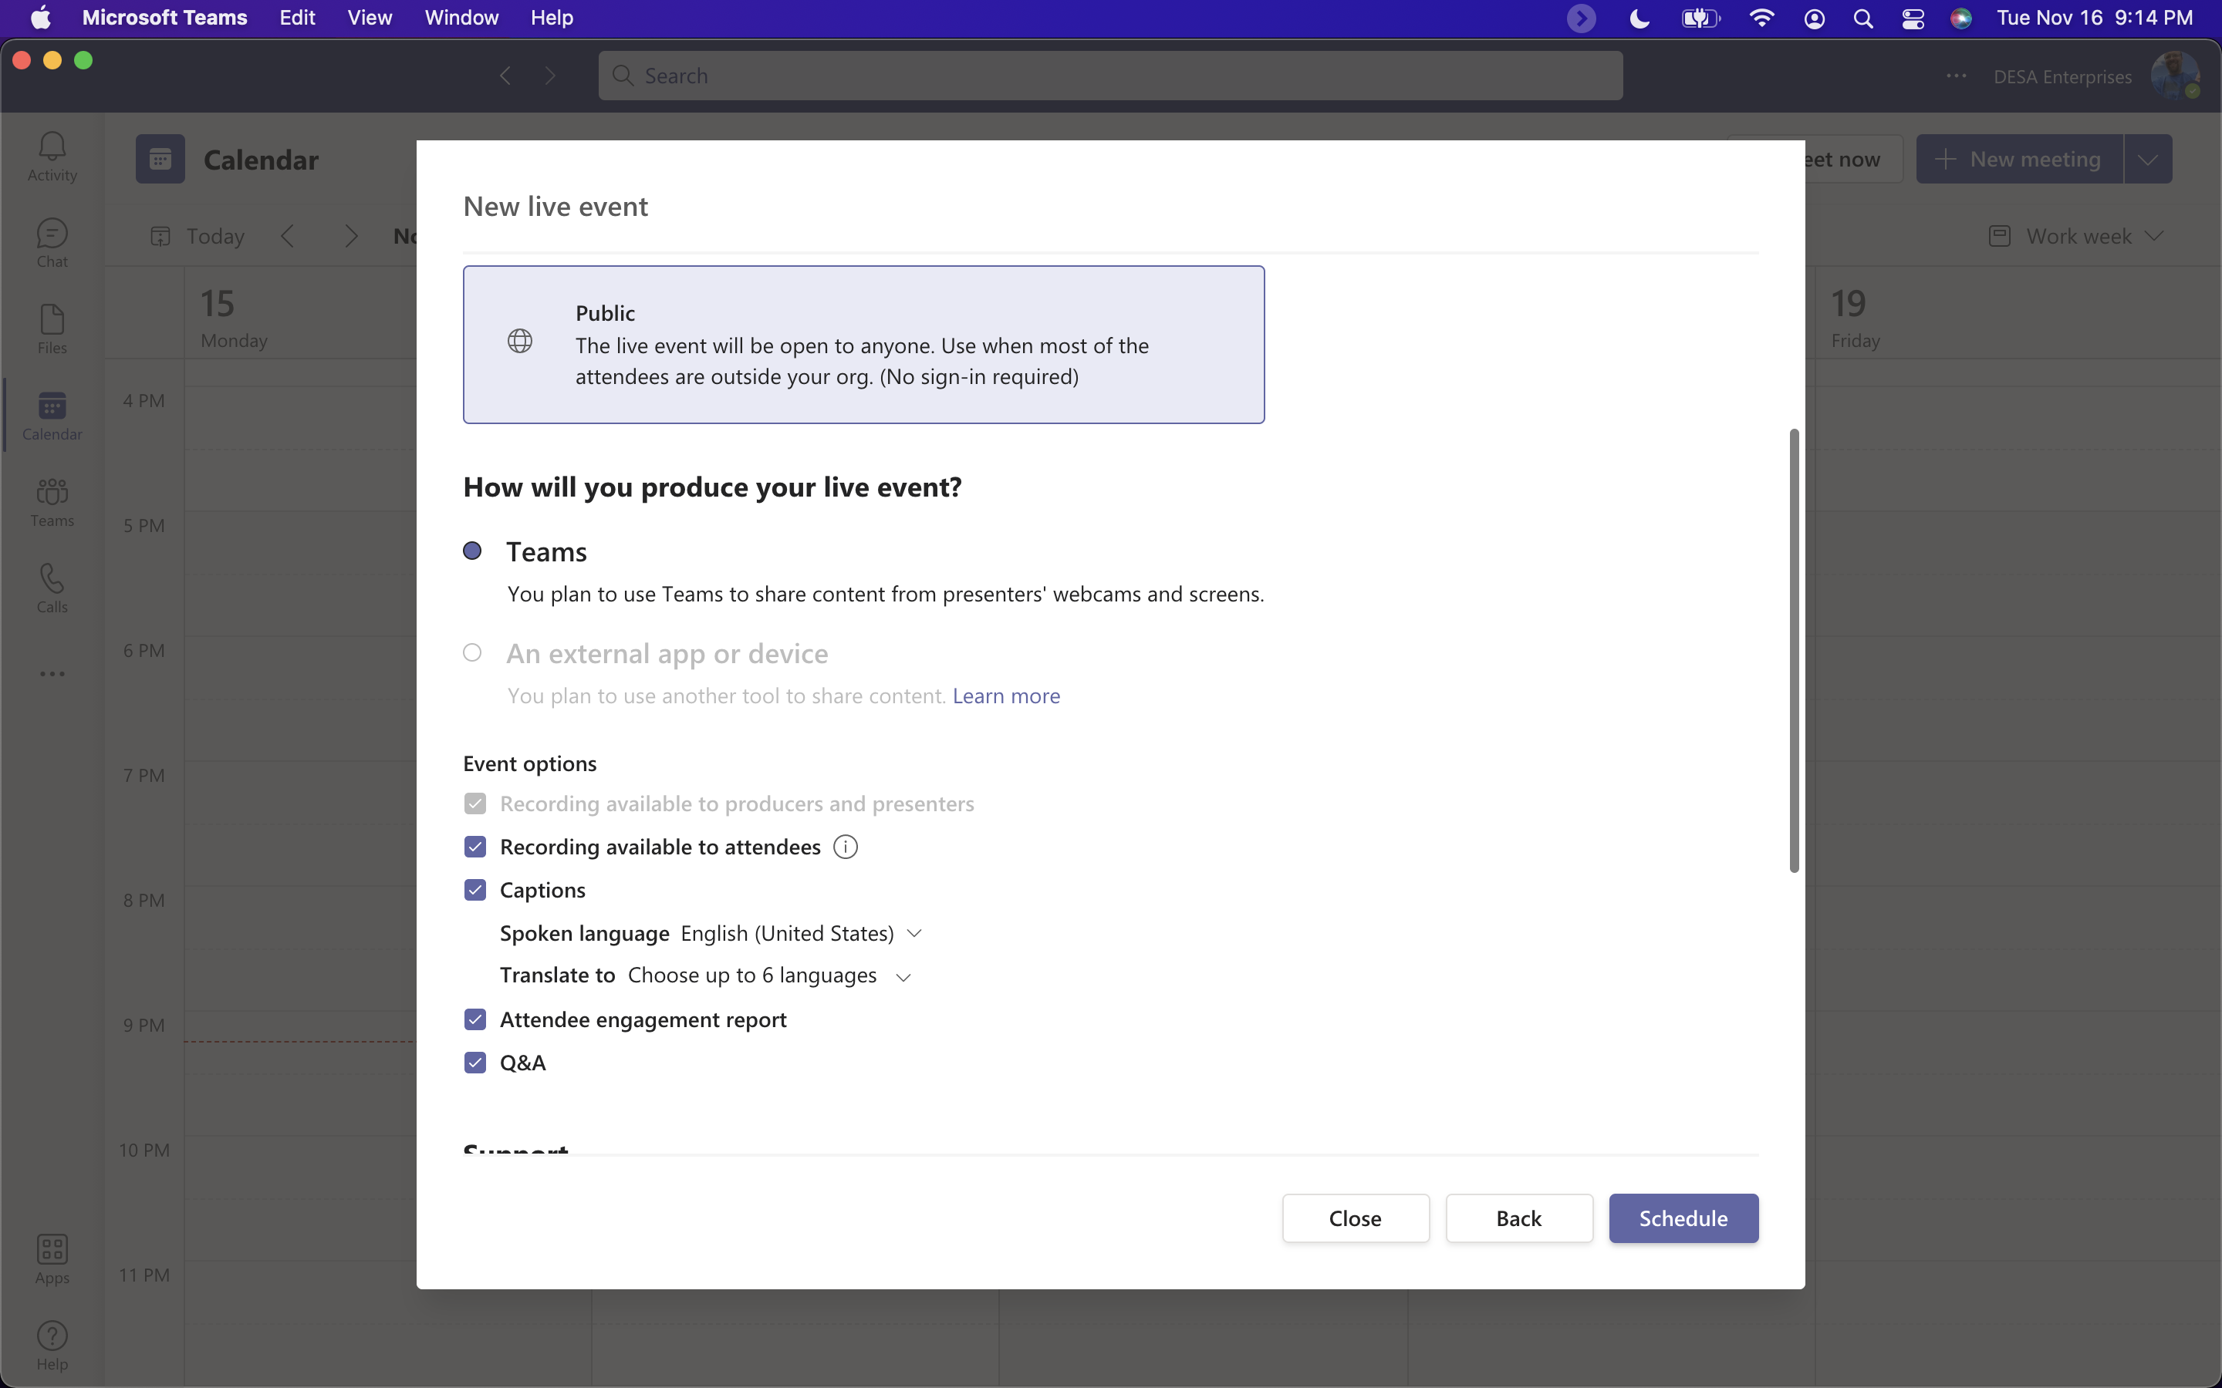
Options with only internal presenters:

Slide 6
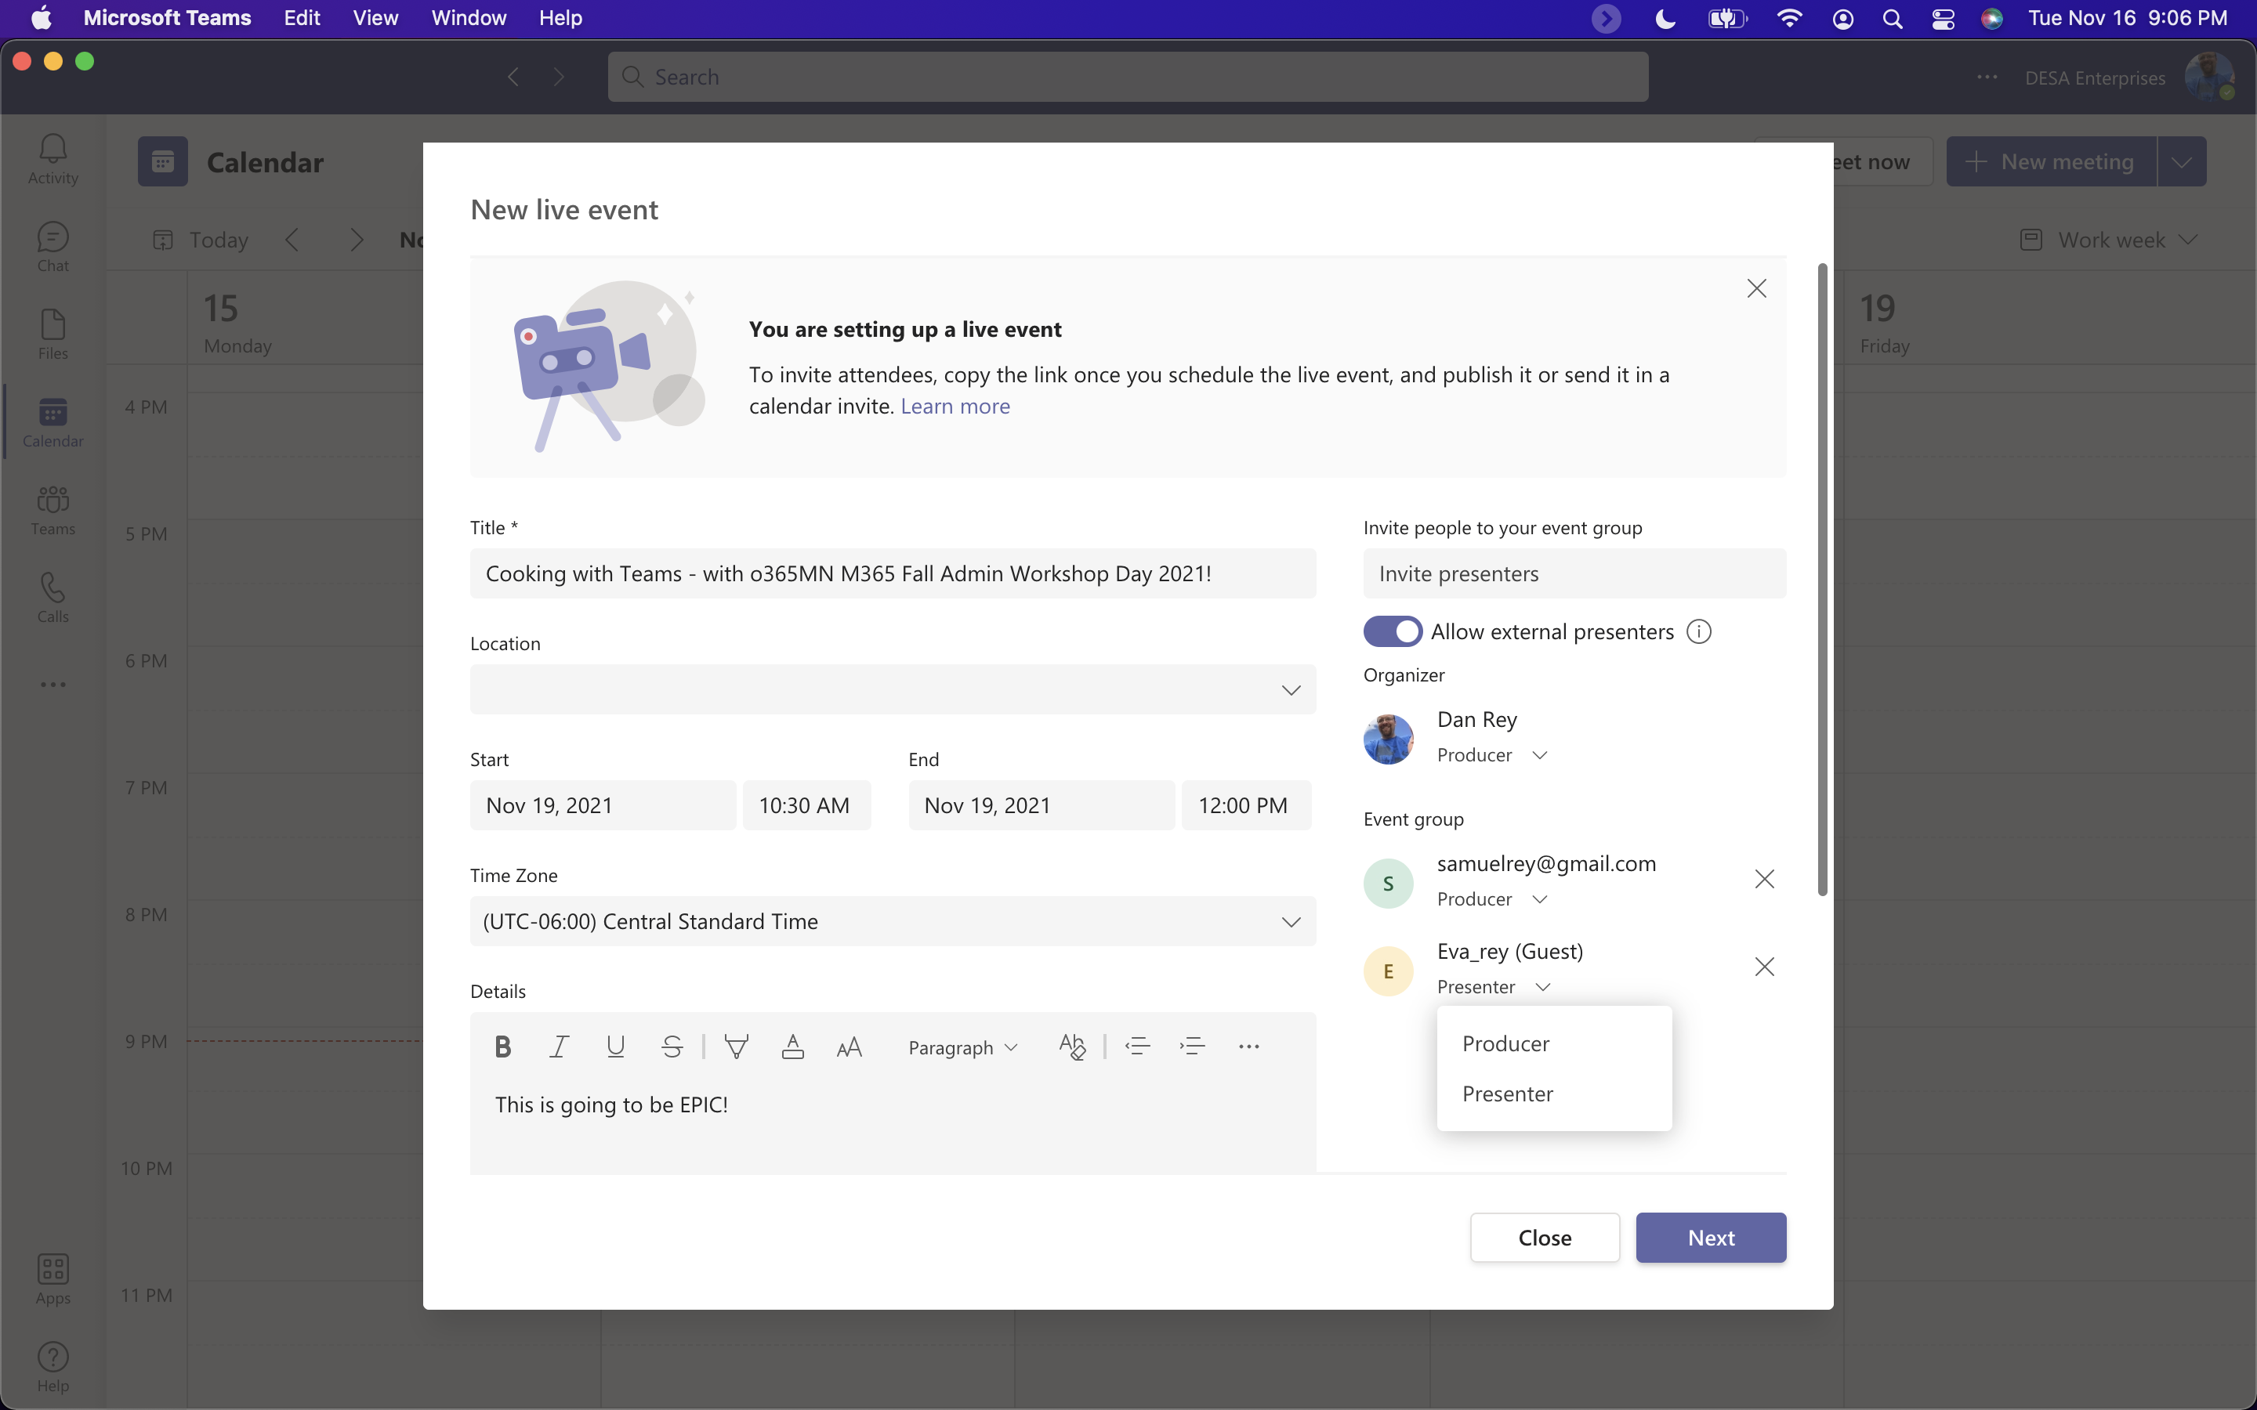
Live Events are PRODUCED

Slide 7
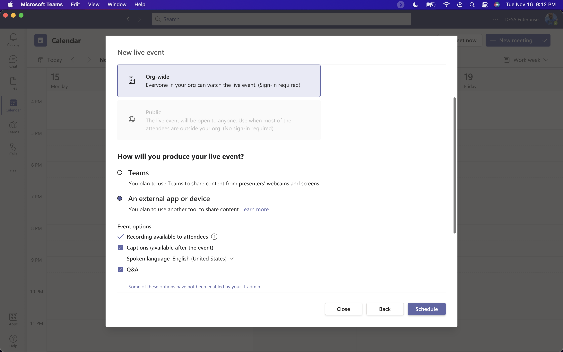
Live Events without external presenters (and external app controls many of those settings!)
Notes:
https://support.microsoft.com/en-us/office/produce-a-teams-live-event-using-an-external-app-or-device-b0026c9d-fd37-4bb3-bffc-6961f221fbe9

Slide 8
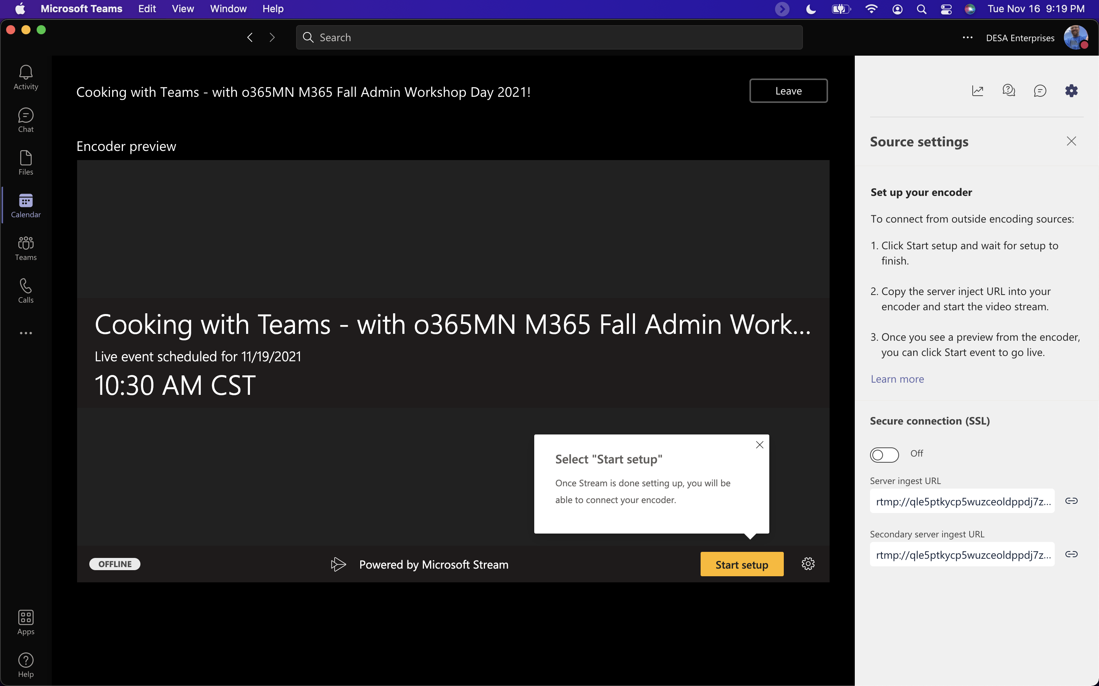
External App or Device

Slide 9
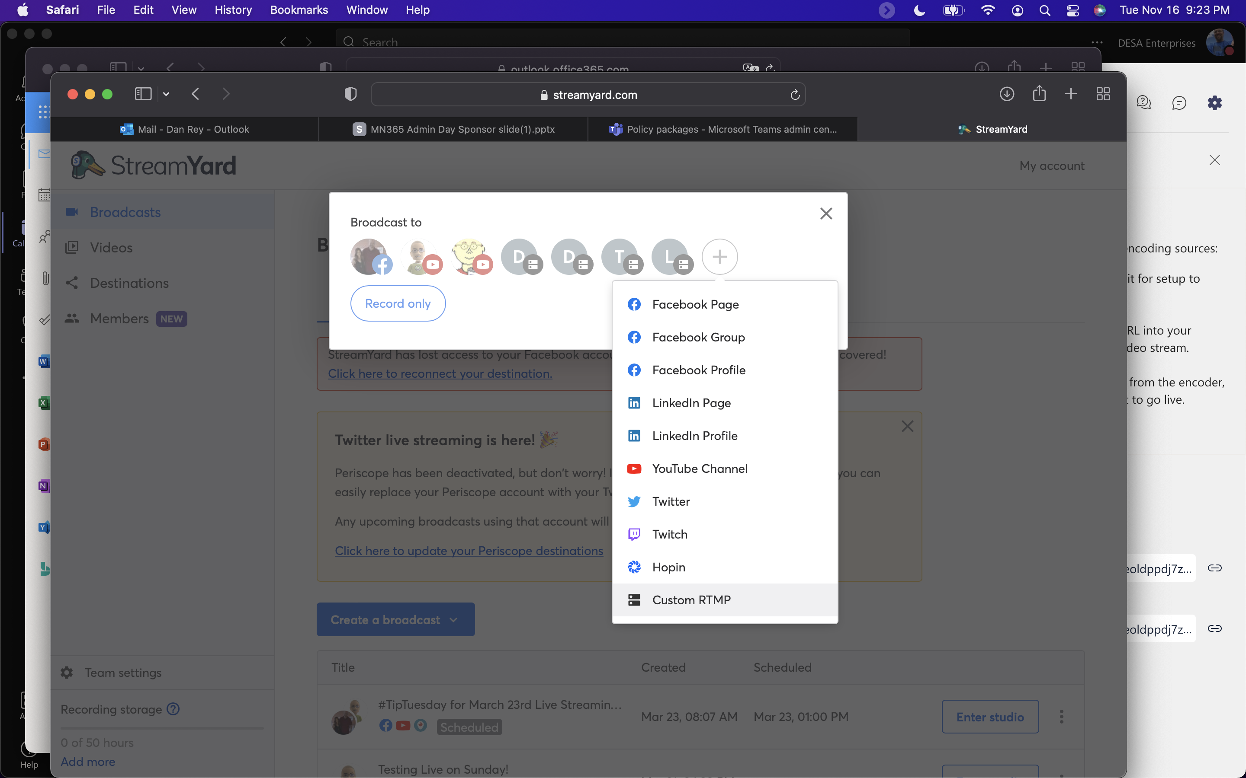
StreamYard – Add a Custom RTMP

Slide 10
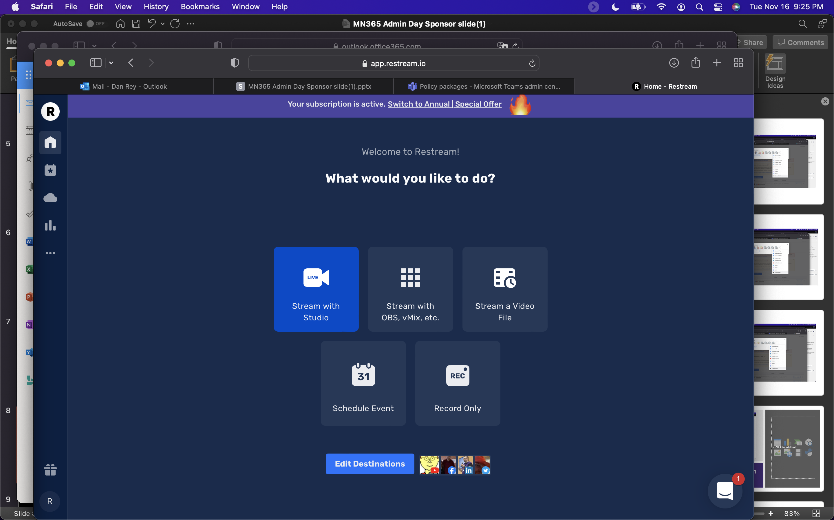
Restream – Edit Destination at the bottom

Slide 11
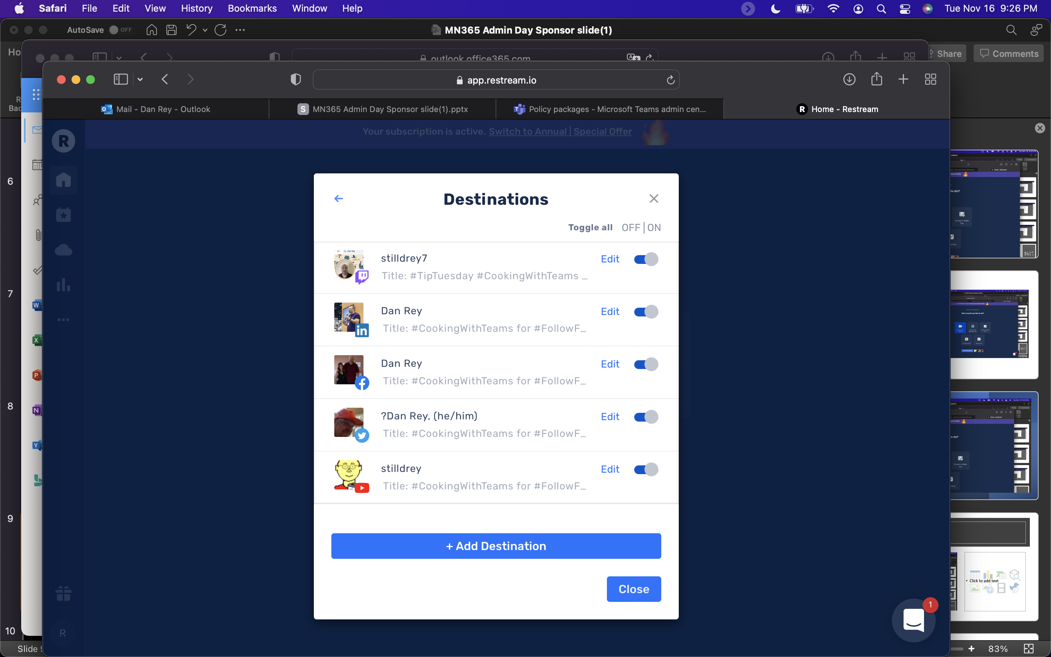
Restream – Add Destination

Slide 12
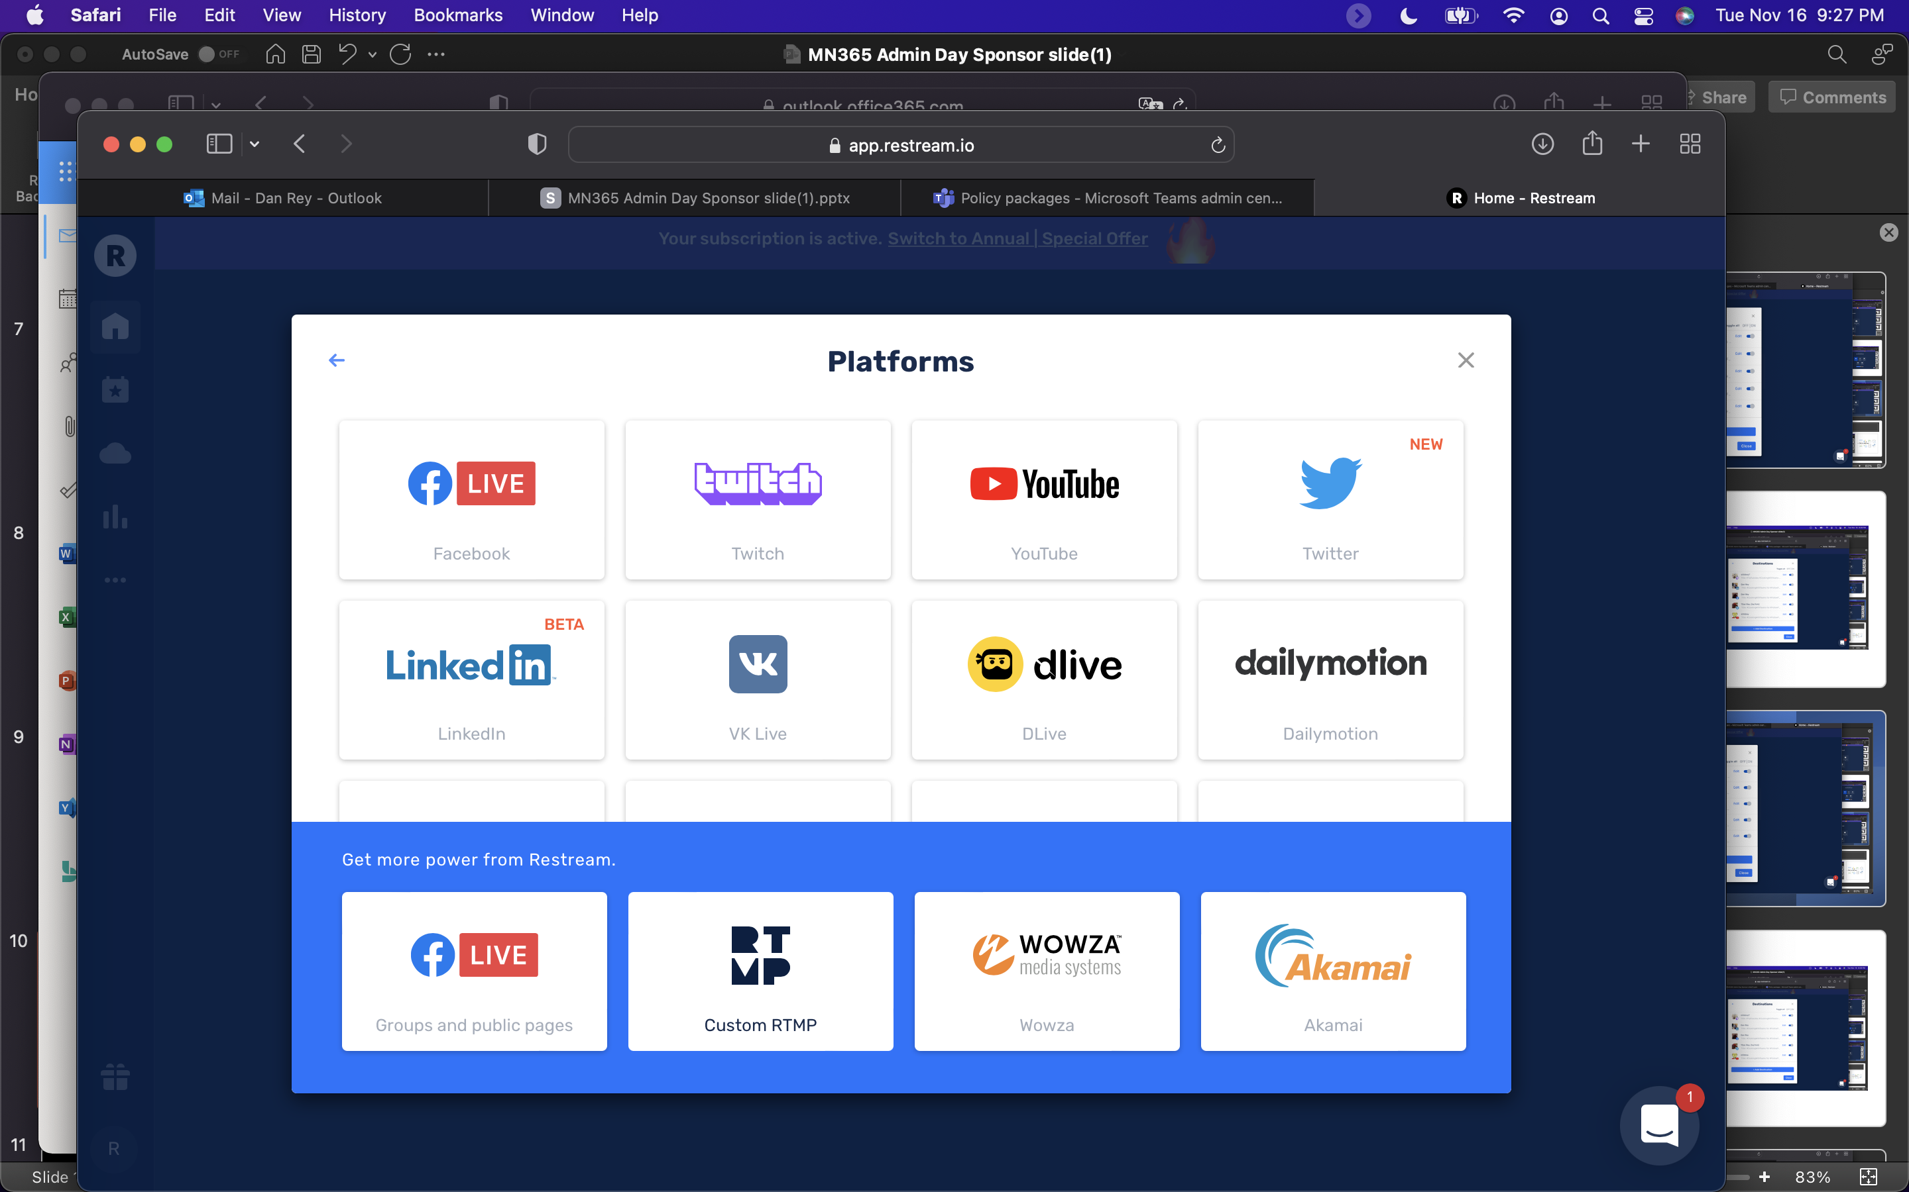
Custom RTMP (Real-Time Messaging Protocol)

Slide 13
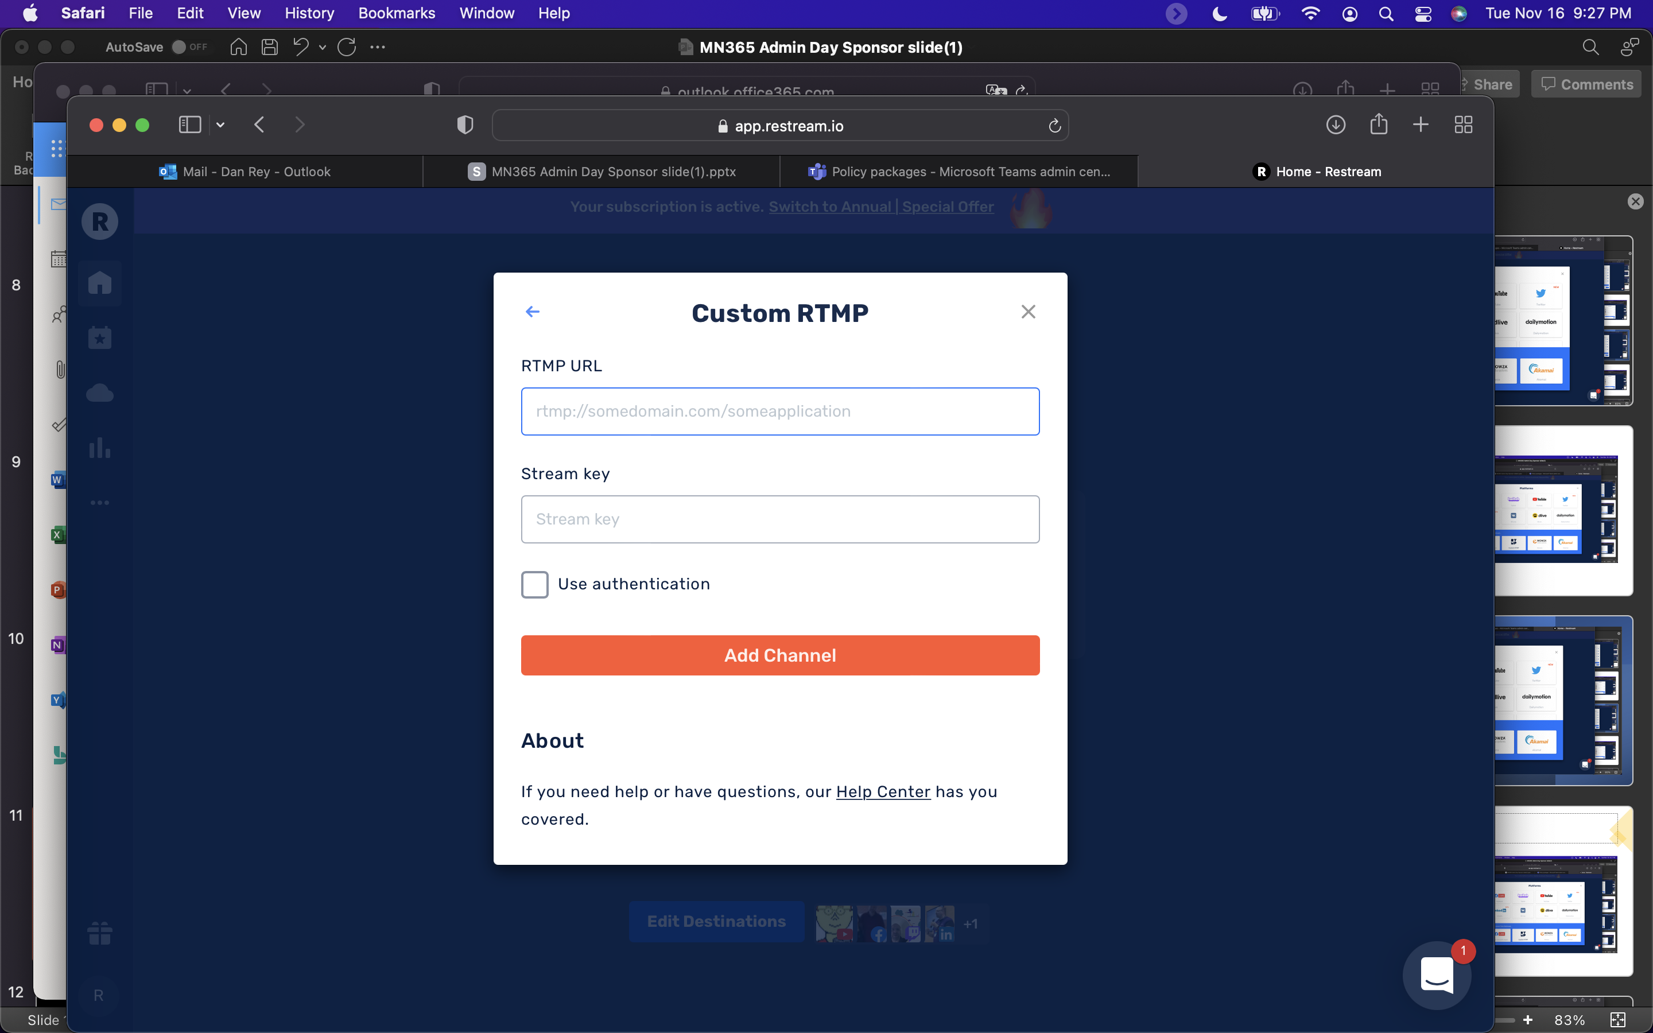
Custom RTMP URL (Don’t Share This publically!)

Slide 14
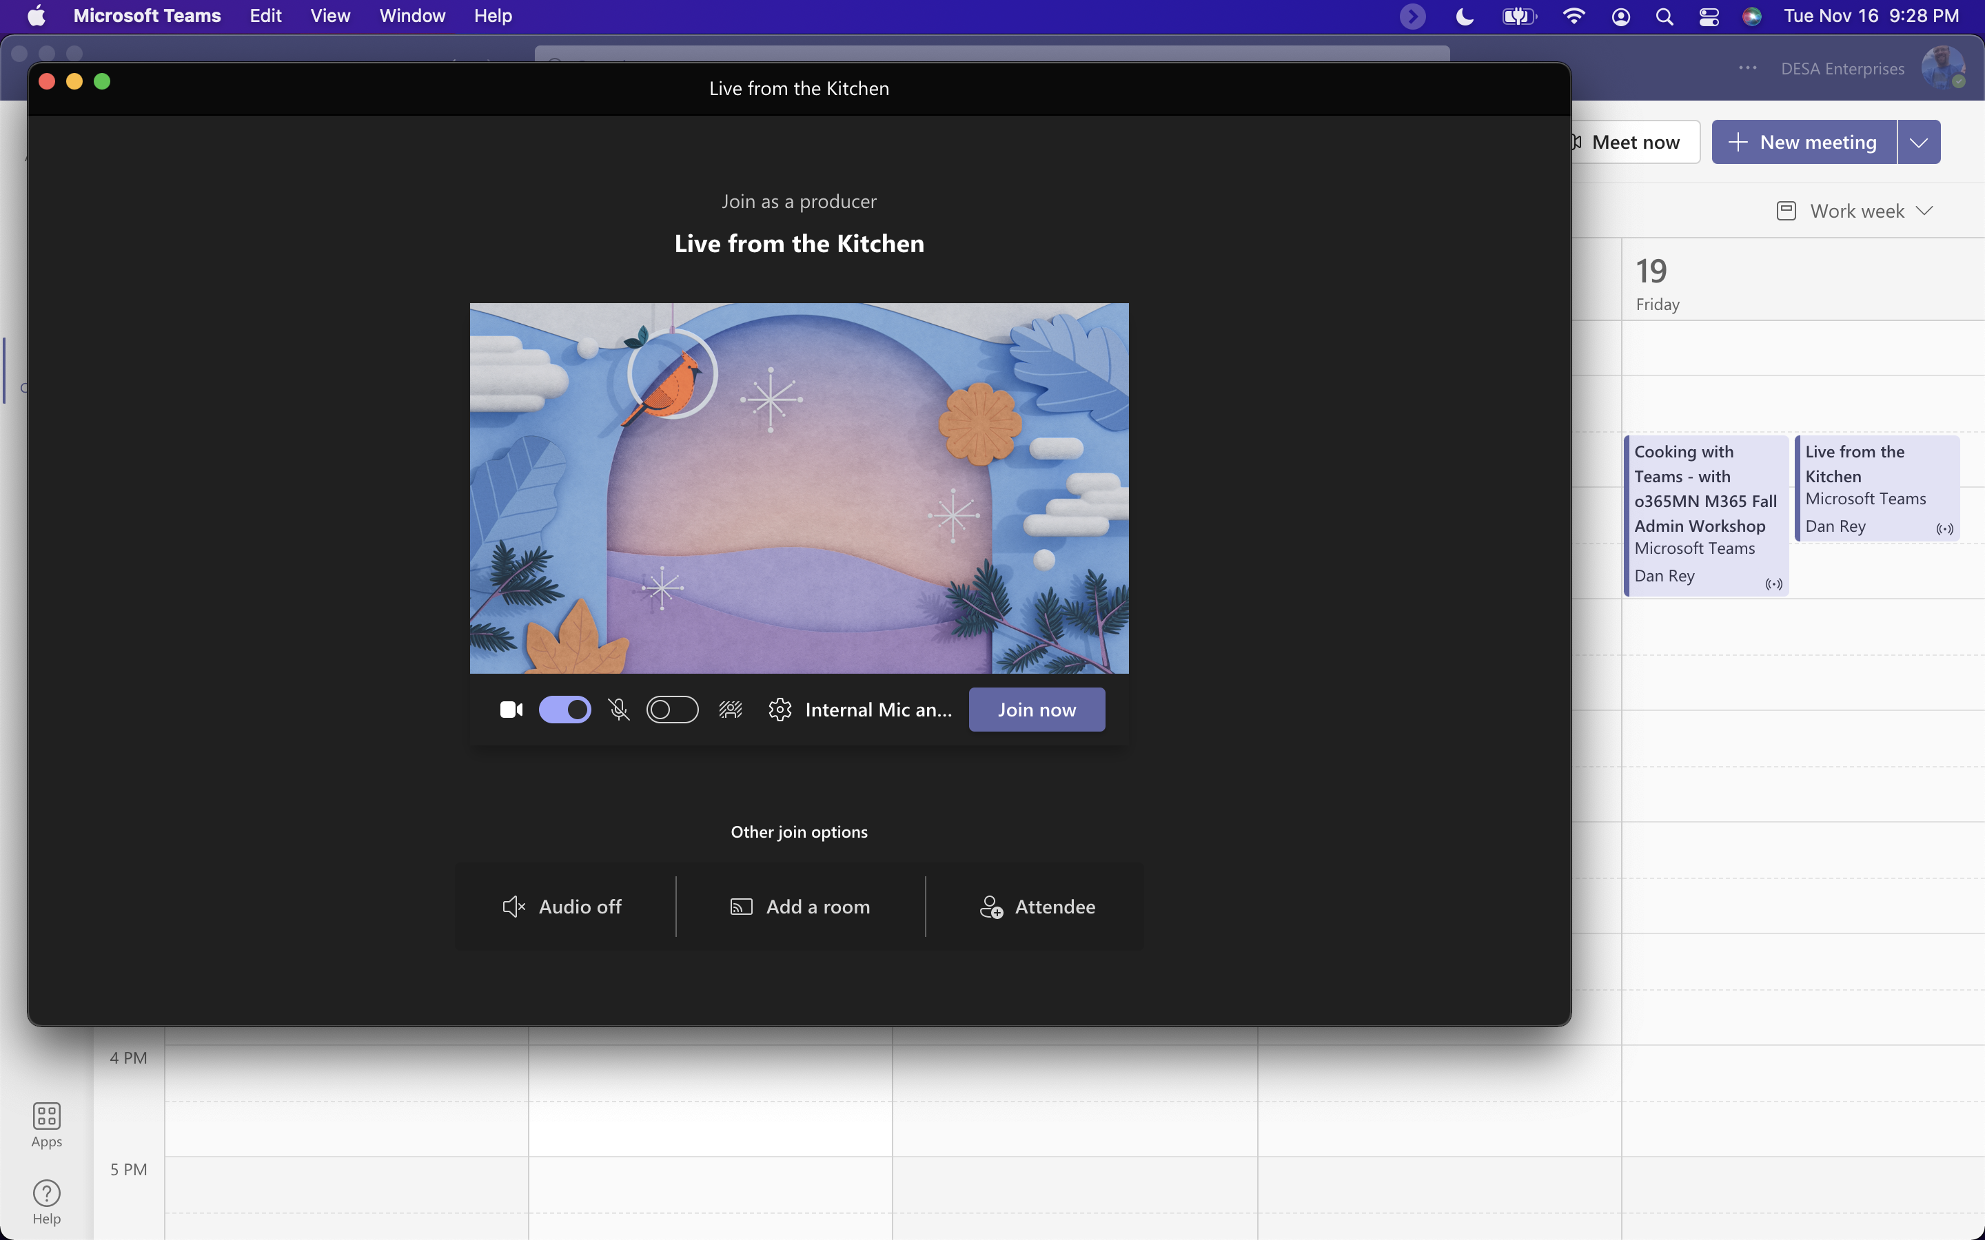
Your Live Event Produced in Microsoft Teams

Slide 15
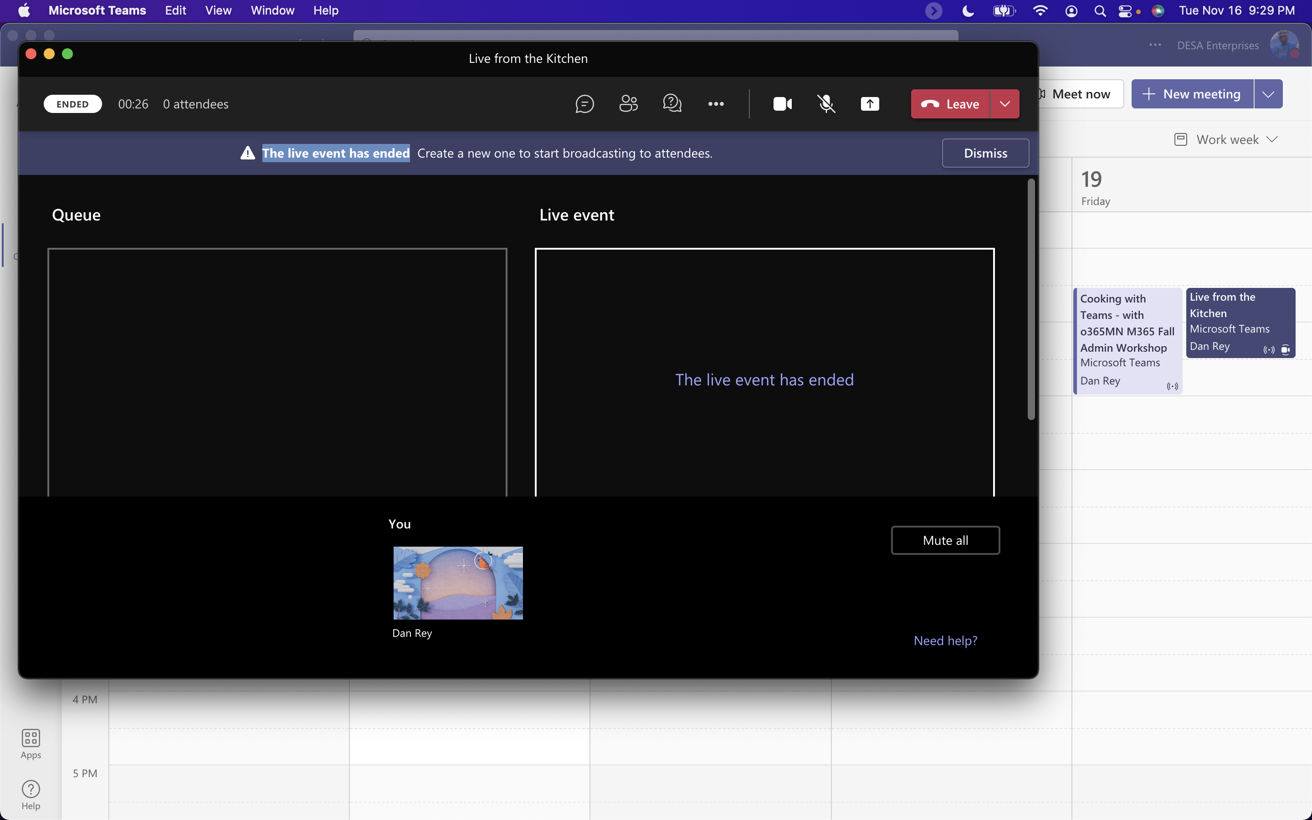
Looks like this (left side preview, right side live stream and start event!)

Slide 16
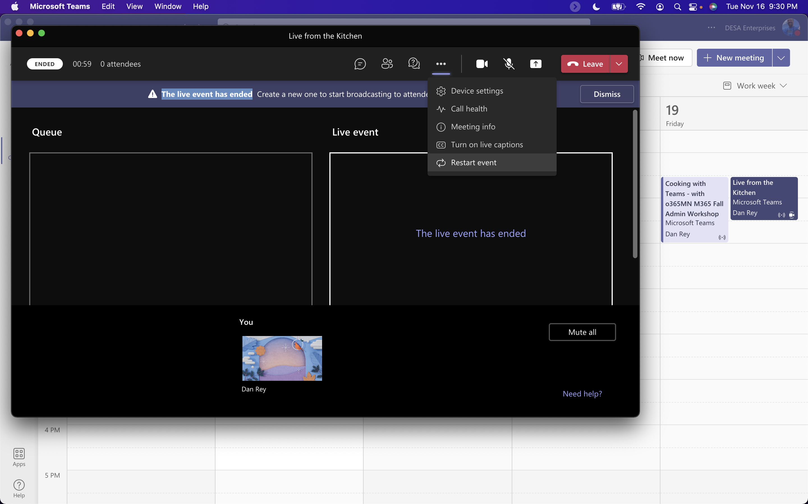
NEW: Restart a Live Event!!!

Slide 17
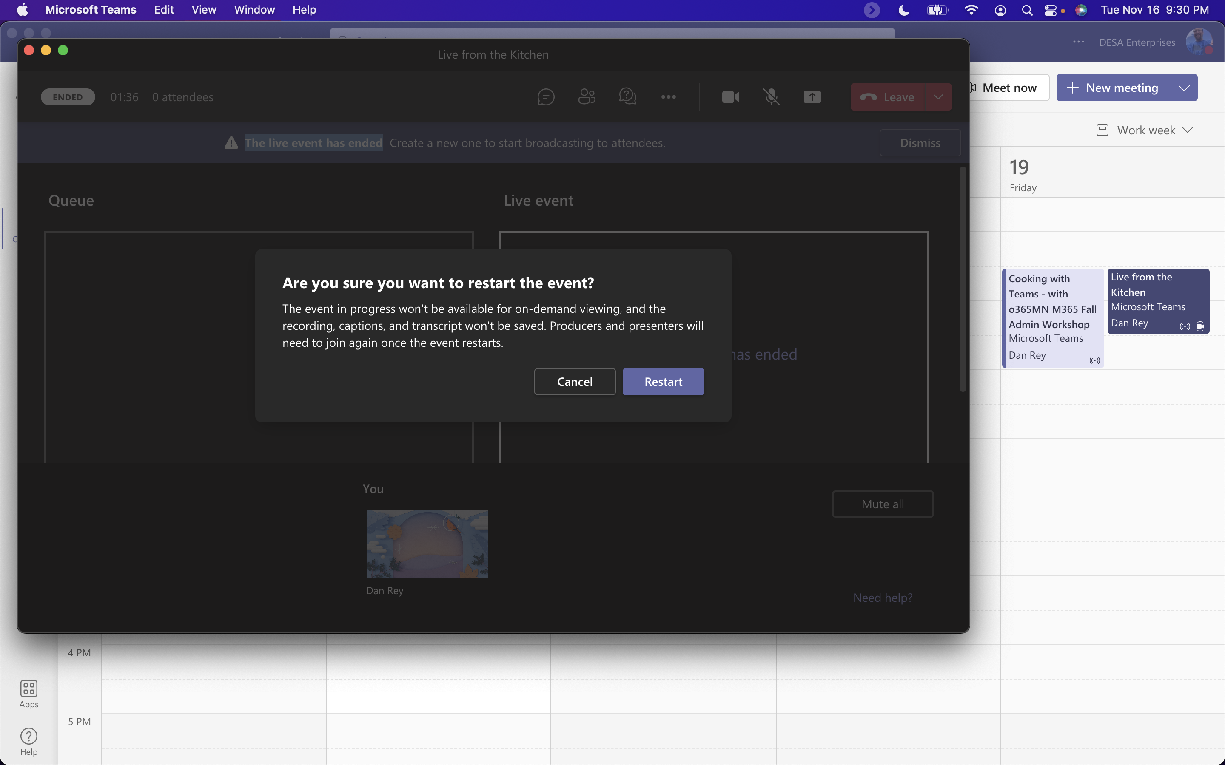
Warning/Implication to restarting a Live Event

Slide 18
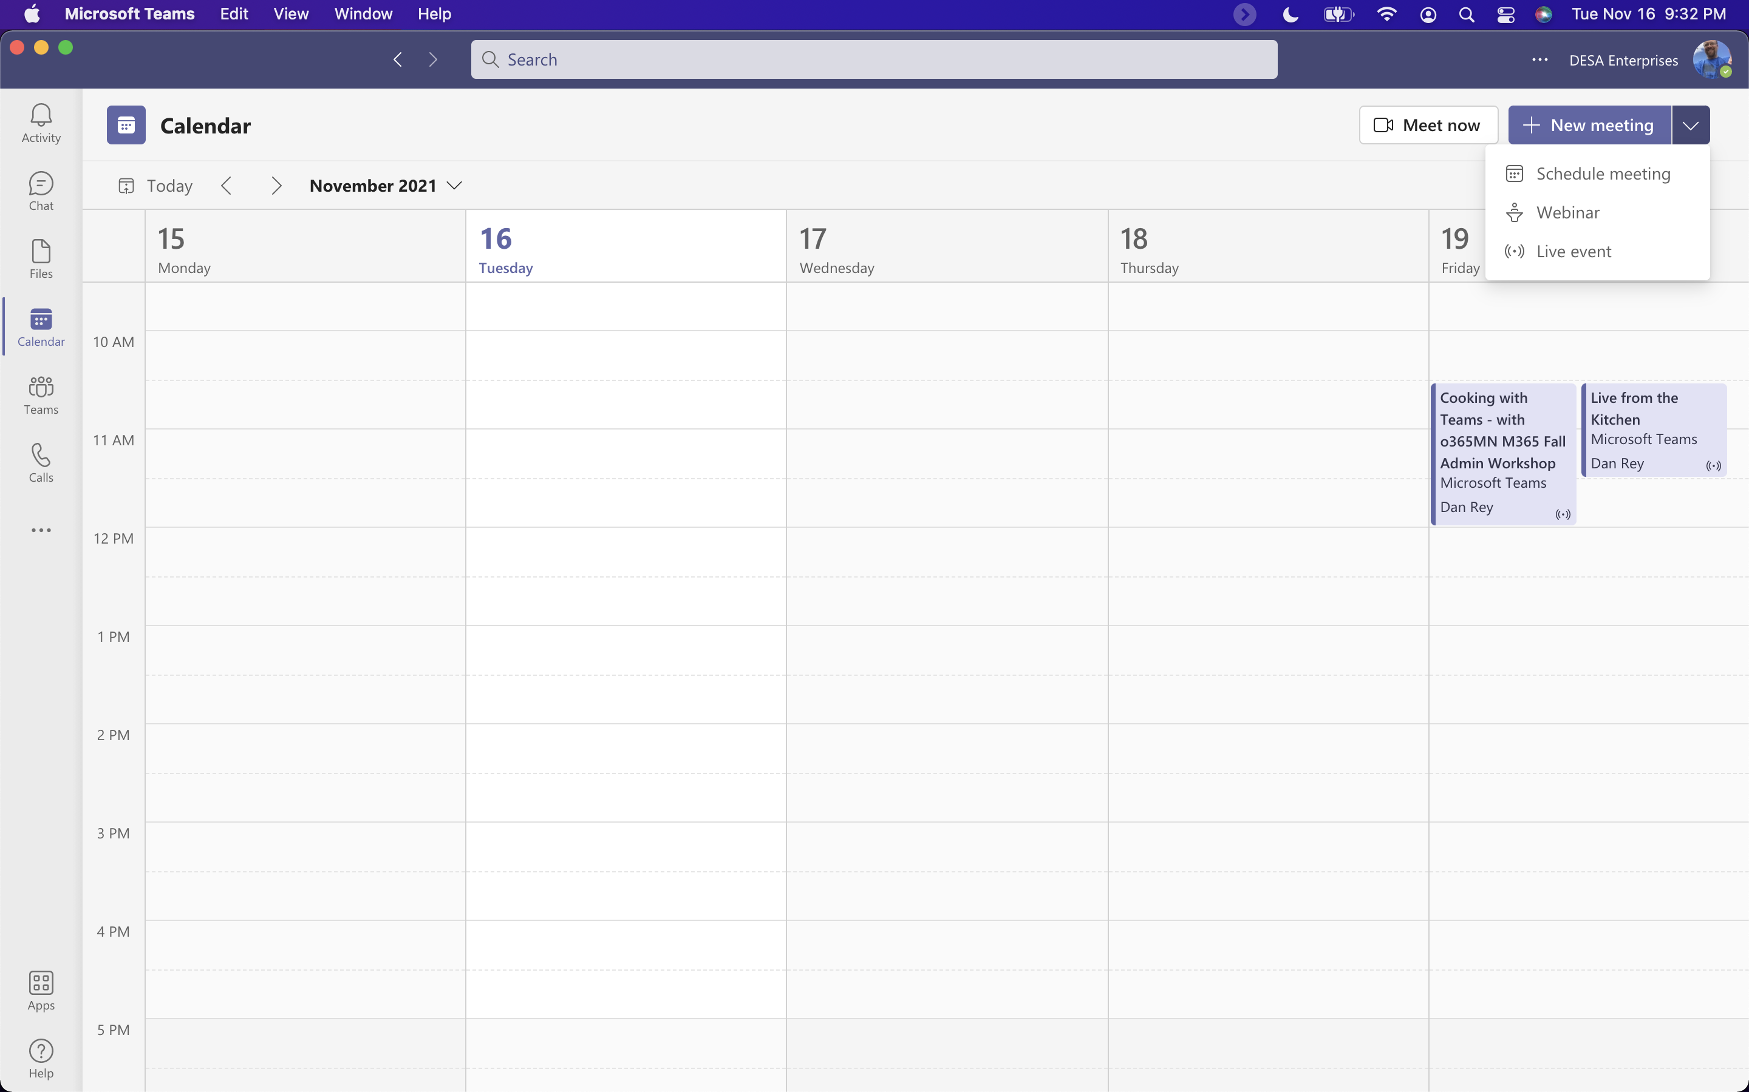
Live Event vs a Webinar

Slide 19
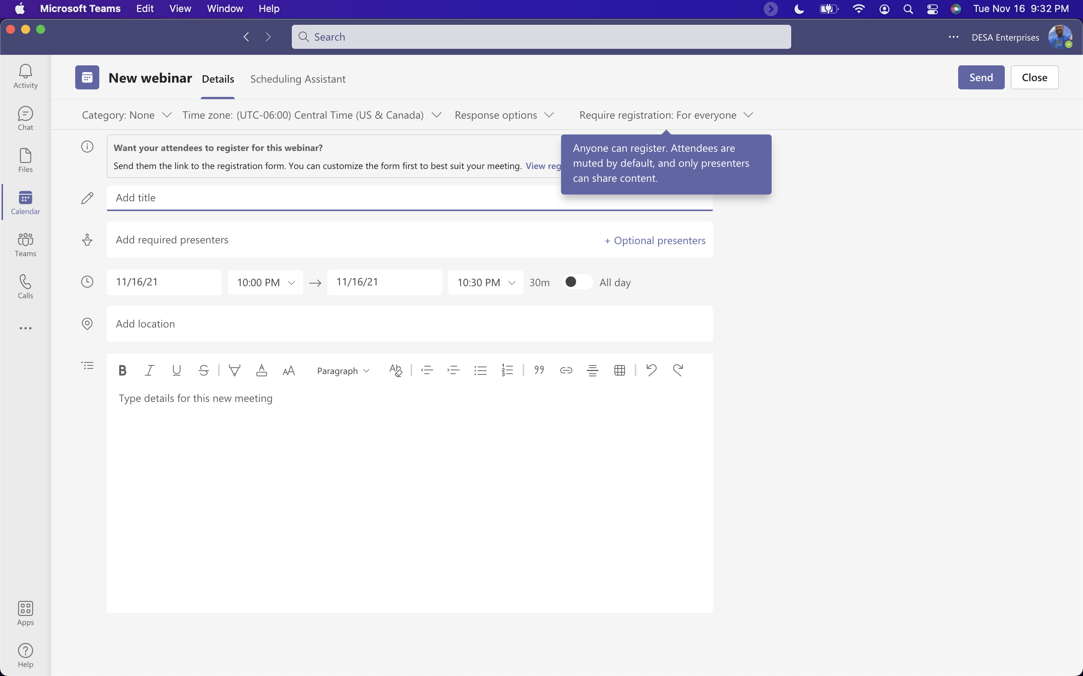
What are some of the settings?

Slide 20
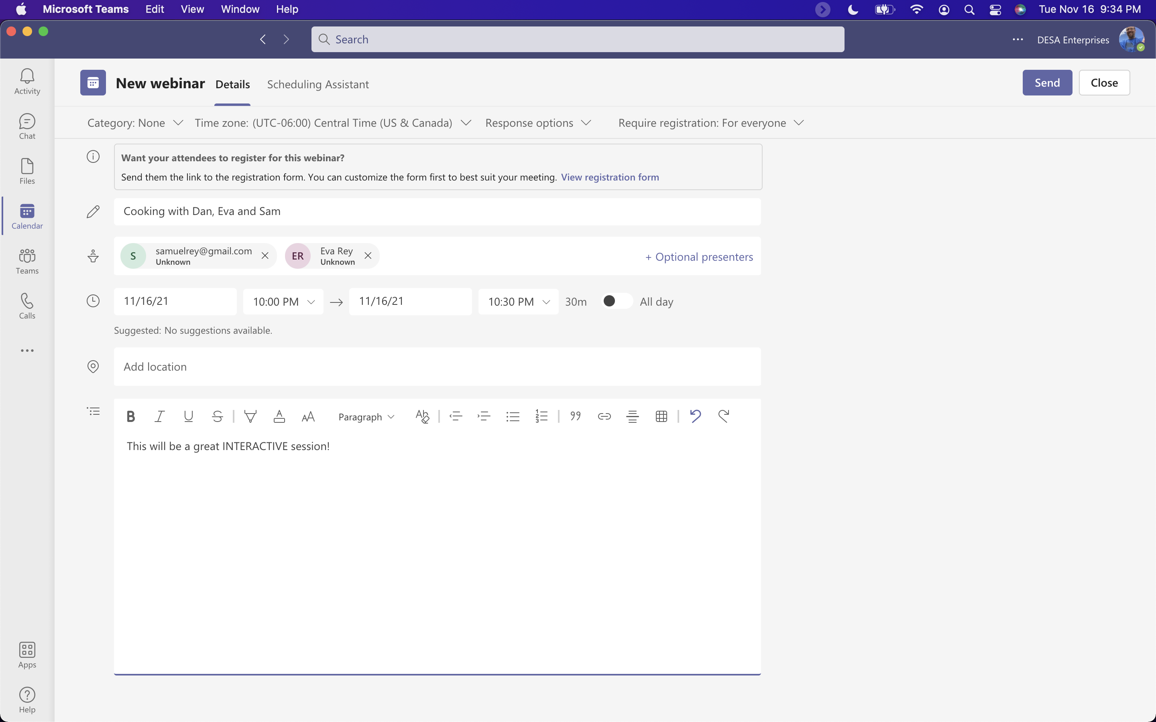
New Webinar

Slide 21
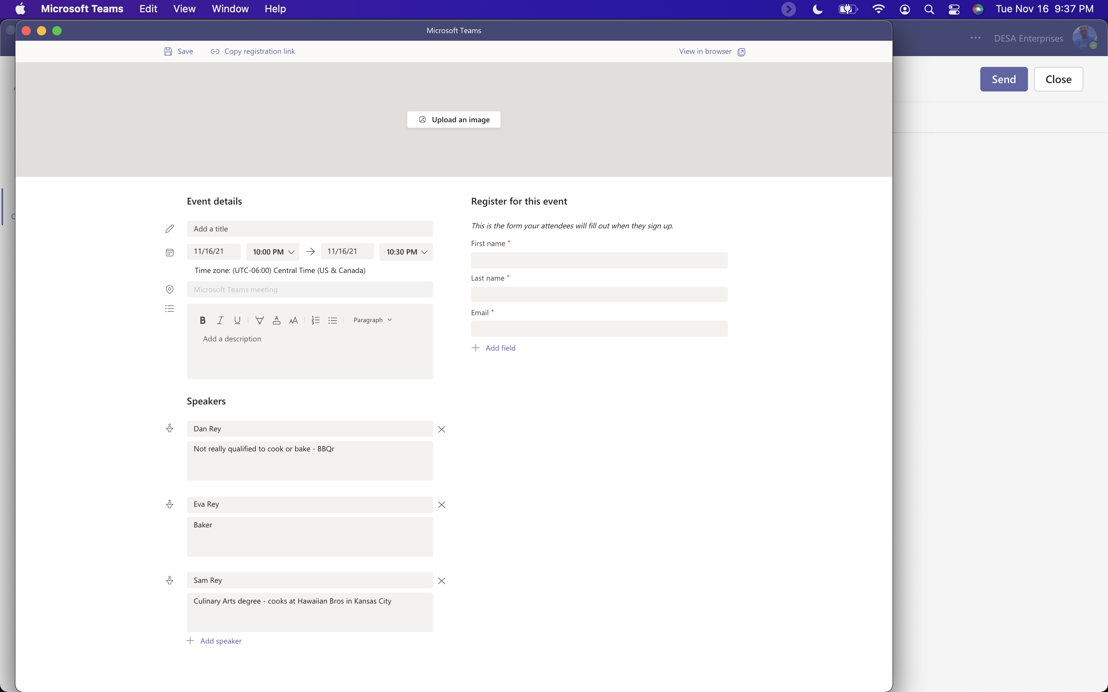
Webinar Registration Options

Slide 22
Live Event vs Webinar
Live Event
Webinar
Produced/thousands in audience
Portions may be live, portions may be prerecorded
Registration must be setup (MS Forms, etc.)
Q&A is moderated
Audience is not able to ask questions
Can use Teams, OBS or a 3rd party app or device
More like a meeting/up to 1,000 participants
Typically a meeting that happens real time (could be recorded)
Registration ahead of time (built into the setup)
Chat is in the meeting with all participants
Audience can interact/be on video/etc. see the chat
Can use Teams, OBS, mobile versions, you have more choices with audience

Slide 23
Thank You To Our Sponsors!

